Slide 1



PROJECT : NALAM
Team ID : Aaro-250 619
PROBLEM STATEMENTS
THE LANGUAGE BARRIER
500+ million Indians cannot type in English or their native dialect. Current "Digital India" apps require text literacy, effectively locking half the population out of governance.
BUREAUCRATIC OPACITY
AGENT DEPENDENCY
Once a physical form is submitted, it enters a "black hole." Citizens have no way to track their application's status in real-time, leading to anxiety and repeated physical visits to offices.
INFORMATION ASYMMETRY
Rural citizens are forced to rely on middlemen to navigate complex interfaces. This creates friction, leads to financial exploitation (bribes), and compromises data privacy.
Thousands of welfare schemes exist, but uptake is low. Citizens remain unaware of their specific eligibility, leading to billions in unclaimed government benefits every year.

Slide 2

PROJECT : NALAM
PROBLEM STATEMENTS
THE LANGUAGE BARRIER
BUREAUCRATIC OPACITY
500+ million Indians cannot type in English or their native dialect. Current "Digital India" apps require text literacy, effectively locking half the population out of governance.
Once a physical form is submitted, it enters a "black hole." Citizens have no way to track their application's status in real-time, leading to anxiety and repeated physical visits to offices.
AGENT DEPENDENCY
INFORMATION ASYMMETRY
Rural citizens are forced to rely on middlemen to navigate complex interfaces. This creates friction, leads to financial exploitation (bribes), and compromises data privacy.
Thousands of welfare schemes exist, but uptake is low. Citizens remain unaware of their specific eligibility, leading to billions in unclaimed government benefits every year.

Slide 3

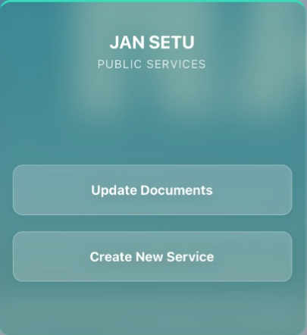
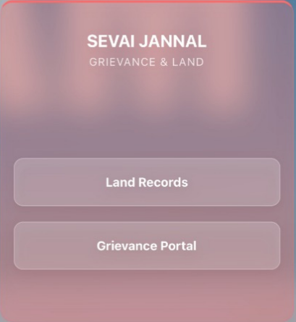

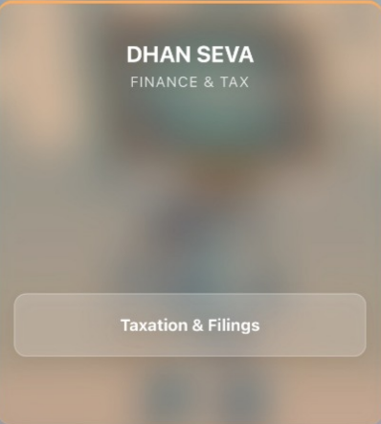
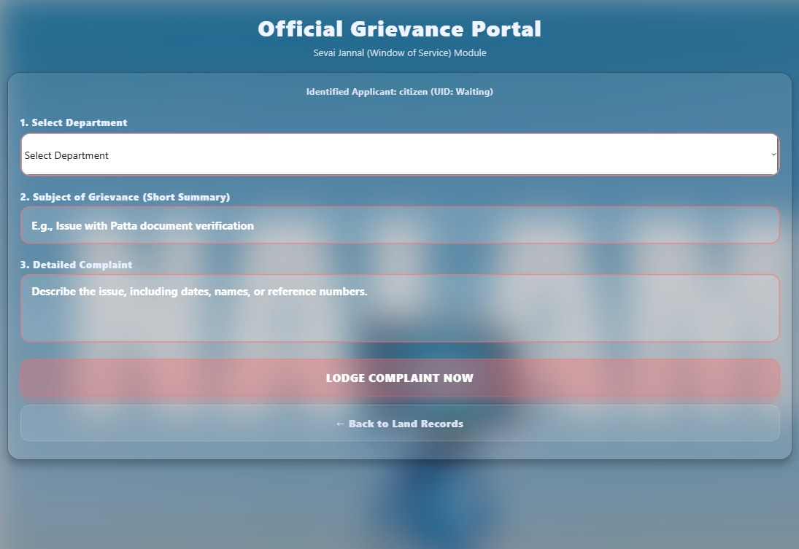
PROJECT : NALAM
Project Nalam is a pioneering "Voice-First" Digital Public Infrastructure initiative designed to bridge the last-mile gap in governance. It serves as a vital link for citizens who are currently excluded from the digital revolution due to language or literacy barriers. The ecosystem is built around rugged, solar-powered "Phygital" kiosks that function reliably even in harsh rural environments. By integrating Bhashini AI to replace complex forms with natural conversation, users can independently access services—from land records to taxes—without agents. Security is paramount, utilizing biometric authentication to ensure that every interaction is safe, private, and fraud-proof.
VOICE-FIRST INTERFACE Literacy/
Language barriers.
BIOMETRIC
SECURITY Focuses on the paramount feature for ensuring safe, private, and fraud-proof transactions.
BHASHINI AI INTEGRATION AI component that enables natural conversation and replaces complex forms.
LAST-MILE GOVERNANCE
DIGITAL & LITERACY INCLUSION

Slide 4

PROJECT : NALAM
Features-Nalam
Multi-Lingual Voice Assistant:This feature is the realization of the project's "Voice-First" mandate, powered by the integrated Bhashini AI. It provides citizens with instant, round-the-clock assistance and replaces complex physical forms with natural conversation. The AI helps overcome language and literacy barriers, ensuring inclusive access to services. Finally, to ensure true Literacy Inclusion, the assistant uses Real-Time Text-to-Speech (TTS) to speak back complex government replies and documents in the citizen's own language, overcoming the barrier of reading comprehension and ensuring constant, 24/7 Decentralized Service availability.
Jan Setu(People's Bridge): This serves as the central digital service window for all citizens. It manages the full spectrum of service requests, from initial application submission through to final delivery. The portal also offers secure digital document management capabilities. This system simplifies citizen interaction, acting as a single, accessible point for obtaining government services.
Grievance Portal: This is the project's dedicated accountability mechanism. It allows citizens to formally lodge complaints or raise issues regarding public services or departments.
Dhan Seva(Wealth/Money Service): As the financial gateway of the platform, this section focuses on fiscal transactions. It allows citizens to view their entire tax history and facilitate the filing of various financial statements and tax returns. The module also manages the distribution of financial subsidies and access to key public finance schemes.
Sevai Janal(Service Window): This module is specifically dedicated to handling high-value official documents. Its core function is to provide transparent and easy access to critical records, such as land titles, property documents, and associated survey data.

Slide 5

Features-Nalam
Operational Relevancy & Scalability
Multi-Lingual Voice Assistant:This feature is the realization of the project's "Voice-First" mandate, powered by the integrated Bhashini AI. It provides citizens with instant, round-the-clock assistance and replaces complex physical forms with natural conversation. The AI helps overcome language and literacy barriers, ensuring inclusive access to services. Finally, to ensure true Literacy Inclusion, the assistant uses Real-Time Text-to-Speech (TTS) to speak back complex government replies and documents in the citizen's own language, overcoming the barrier of reading comprehension and ensuring constant, 24/7 Decentralized Service availability.
Operational Relevancy:
The project scales using an Asset-Light Expansion Model and achieves Net-Zero Fiscal Impact through the "Smart Node" Micro-Utility mechanism, where revenue from hyperlocal data and media leases fully covers operational costs. Infrastructure rollout is accelerated by a PPP "Tower Company" Strategy, allowing Private Telcos to lease asset space for 5G Small Cells, which subsidizes connectivity. Technical resilience is guaranteed by a Federated Architecture utilizing Local Edge Compute, ensuring decentralized service continuity even during internet outages and enabling unlimited horizontal scaling.
Jan Setu(People's Bridge): This serves as the central digital service window for all citizens. It manages the full spectrum of service requests, from initial application submission through to final delivery. The portal also offers secure digital document management capabilities. This system simplifies citizen interaction, acting as a single, accessible point for obtaining government services.
Scalability:
The project scales using an Asset-Light Expansion Model and achieves Net-Zero Fiscal Impact through the "Smart Node" Micro-Utility mechanism, where revenue from hyperlocal data and media leases fully covers operational costs. Infrastructure rollout is accelerated by a PPP "Tower Company" Strategy, allowing Private Telcos to lease asset space for 5G Small Cells, which subsidizes connectivity. Technical resilience is guaranteed by a Federated Architecture utilizing Local Edge Compute, ensuring decentralized service continuity even during internet outages and enabling unlimited horizontal scaling.
Grievance Portal: This is the project's dedicated accountability mechanism. It allows citizens to formally lodge complaints or raise issues regarding public services or departments.
Dhan Seva(Wealth/Money Service): As the financial gateway of the platform, this section focuses on fiscal transactions. It allows citizens to view their entire tax history and facilitate the filing of various financial statements and tax returns. The module also manages the distribution of financial subsidies and access to key public finance schemes.
Sevai Janal(Service Window): This module is specifically dedicated to handling high-value official documents. Its core function is to provide transparent and easy access to critical records, such as land titles, property documents, and associated survey data.

Slide 6

Operational Relevancy & Scalability
Operational Relevancy:
The project scales using an Asset-Light Expansion Model and achieves Net-Zero Fiscal Impact through the "Smart Node" Micro-Utility mechanism, where revenue from hyperlocal data and media leases fully covers operational costs. Infrastructure rollout is accelerated by a PPP "Tower Company" Strategy, allowing Private Telcos to lease asset space for 5G Small Cells, which subsidizes connectivity. Technical resilience is guaranteed by a Federated Architecture utilizing Local Edge Compute, ensuring decentralized service continuity even during internet outages and enabling unlimited horizontal scaling.
Scalability:
The project scales using an Asset-Light Expansion Model and achieves Net-Zero Fiscal Impact through the "Smart Node" Micro-Utility mechanism, where revenue from hyperlocal data and media leases fully covers operational costs. Infrastructure rollout is accelerated by a PPP "Tower Company" Strategy, allowing Private Telcos to lease asset space for 5G Small Cells, which subsidizes connectivity. Technical resilience is guaranteed by a Federated Architecture utilizing Local Edge Compute, ensuring decentralized service continuity even during internet outages and enabling unlimited horizontal scaling.
v

Slide 7
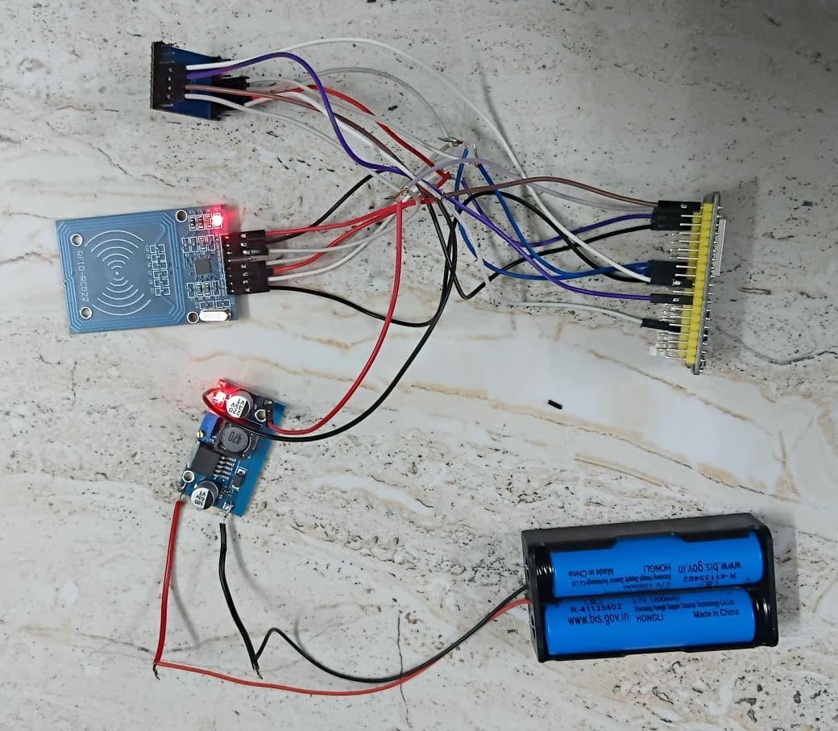
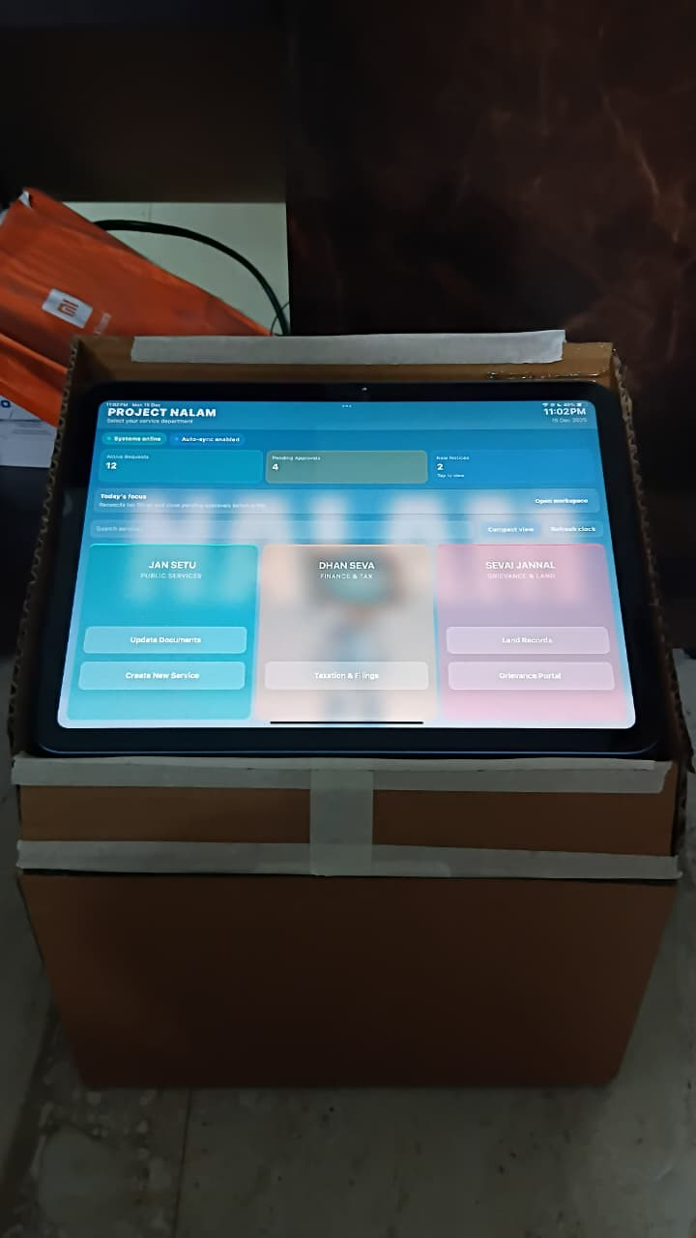
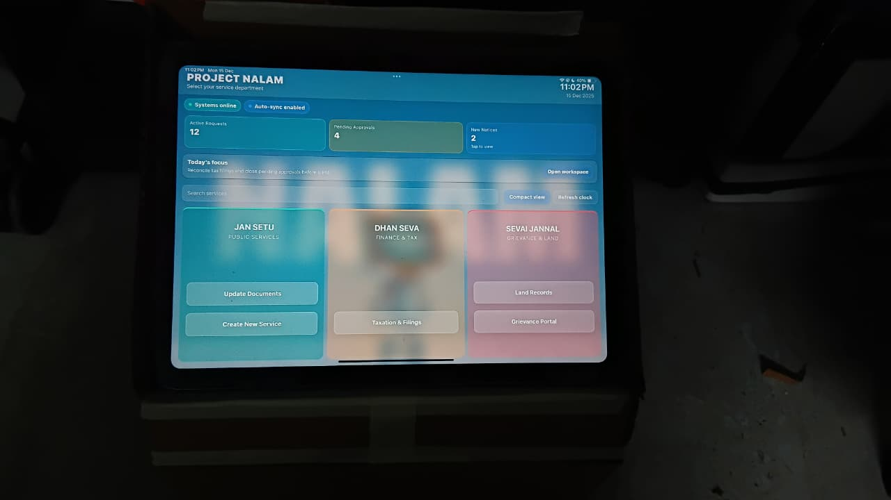
->Sensor Circuit
Kiosk-Top View->
Kiosk-Front View

Slide 8



Implementation Stages
1. Preparatory Stage: Blueprinting & Edge Configuration
This foundational stage ensures the platform's unique technical architecture and operational readiness align perfectly with the "last-mile" environment. This involves finalizing the API Setu integration with core legacy government databases. Rigorous stress-testing of the Local Edge Compute units within the solar kiosks is conducted to guarantee performance during peak load and internet disconnection scenarios. Concurrently, the Bhashini Multi-Lingual AI engine undergoes final training for dialect fine-tuning and Text-to-Speech (TTS) clarity, and final regulatory clearances for Biometric Security are obtained.
2. Deployment Stage: Phased Rollout & Hypercare
This stage executes the physical and digital launch of the infrastructure, prioritizing controlled expansion and intensive, localized support to manage the technological shift. A strategic, regional rollout—a "Smart Cluster Rollout"—is initiated, which includes the physical installation of the Solar-Powered Kiotams and verification of the 5G Small Cell signal Extensive, on-the-ground training is provided to users to build confidence with the Voice-First Interface. An intensive, immediate Hypercare Support period follows the launch to quickly address usability issues, authenticated citizen data into the new system.
3. Optimization Stage: Governance Maturation & Scalability
This stage ensures long-term viability, efficiency, and continuous improvement across financial and service delivery pillars. It involves maximizing revenue from hyperlocal data sales and leased media/vertical space to secure the Net-Zero Fiscal Impact model. Based on analytics from the Grievance Portal and usage data, new services are iteratively added, committing to a Continuous Feedback Loop for refining AI accuracy. Finally, the operational management is formally handed over, preparing the framework for the next phase of the Asset-Light Expansion Model.

Slide 9
Links: Prototype Demonstration:
Github Repository Link: https://github.com/I-am-Chittesh/Project-Nalam

